Slide 1
Fourth Meeting of SAARC Cabinet Secretaries Kathmandu, 09-10 June 2016 Bangladesh Position Paper on Best Practices: Governance Issues
Mohammad Shafiul Alam
Cabinet Secretary
Government of the People’s Republic of Bangladesh

Slide 2
3rd Meeting Issues: Overview
a. Administrative Reforms and Governance
Specialisation in Bureaucracy
Improving Office Management
National e-Service System (NESS)
Online Monitoring
Electronic Government Procurement (e-GP)
Transparency and Proactive Disclosure
Measures towards Prevention of Corruption
Mobile Courts for Curbing Petty Offences
Grievance Redress System
Promoting Innovation

Slide 3
3rd Meeting Issues: Overview(contd…)
b. Capacity Building
National Skills Development Policy
National Skills Development Council (NSDC)
Technical Training of Workers
Skills Development in Education Sector
c. Improvement in Service Delivery
Deployment of ICT in Public Service Delivery
E-health Services
Improving Services on Education
Agriculture Call Centre
Improving Judicial Services Management System

Slide 4
3rd Meeting Issues: Overview
d. Performance Evaluation and Management
Performance-based Evaluation System
Medium Term Budget Framework
Annual Performance Agreement (APA)

Slide 5
4th Meeting Issues
e-Filing
e-Filing is introduced in the government offices as the advance form of previously used National e-Service System (NESS)
It is taken as an essential part of mandatory strategic objectives of Annual Performance Agreement(APA)
It will cover 19000 offices across the government
On-line confidential reporting from Field Administration to the Cabinet Division saves time and paper works

Slide 6
e-Mobile Court
e-mobile Court provides scope of higher authority to monitor the activities of the mobile courts
The Executive Magistrates can get all the new laws immediately and can take a look at the previous case records
Activities of the mobile courts can be done quickly and efficiently through the use of information technology
The digital copy of case record can be supplied easily and quickly
Data regarding the crimes committed by the same person can be verified online
This system provides the scope of analysis of criminal trends
e-mobile Court ensures transparency and accountability

Slide 8
Innovation for Better Governance
Innovation team has been formed in almost 1000 government offices for improving service delivery
There are 380 innovative ideas are taken for piloting in government offices
Steps have been taken to provide Service Innovation Funds even at the peripheral government officials
Service delivery is enhanced by Service Process Simplification
Inspiring Upazila innovation committees by connecting in their monthly meetings through audio/video conferencing and providing proper instructions to them.
Inspiring new innovators by rewarding “District Innovation Award”.

Slide 9
Innovation Circle
Innovation is taken as a change making tool
Innovation Circles are organized at central to grass root levels
Innovation ideas are being presented, discussed, evaluated in the circles
Innovation is supported by special type of fund- Service Innovation Fund
Outstanding innovation ideas are taken for piloting

Slide 10
Idea Bank: innovation ideas
Innovation ideas for better governance are being encouraged
Innovation ideas are being recorded & registered
To acknowledge
To preserve the copyright
To avoid duplication

Slide 11
Public Hearing
Public hearing is introduced in all field level offices
All district offices organize public hearing on weekly basis ( Wednesday) :
To know the citizens’ problem
To give quick solutions to citizens’ need
To get feedback on service delivery
To redress the public grievances
Having Public hearing through Skype/Video Conferencing to solve various problems of rural people in innovative ways

Slide 12
Use of Social Media
The official social pages of government offices act as an innovative tool in order to make Government services visible to the common people
Social media pages serve the citizens instantly for receiving applications, complaints & feedbacks from them
District Administrations have initiated the social media dialogues & issue based social media dialogues in Bangladesh for accelerating innovative endeavors to assimilate common people with the Government offices through social networking sites.

Slide 13
Use of Social Media
Use of social media at central and Field Administration for-
Information dissemination
Motivational activities
Awareness raising
Quick service delivery
Grievance redressal

Slide 14
Rural Citizen Journalism for Good Governance
Rural citizen journalism is introduced in some field level offices-
To get the public servants involved in citizens’ daily life
To know the people at the grassroots level
To hear from the people as they feel
To ensure social auditing of public offices

Slide 15
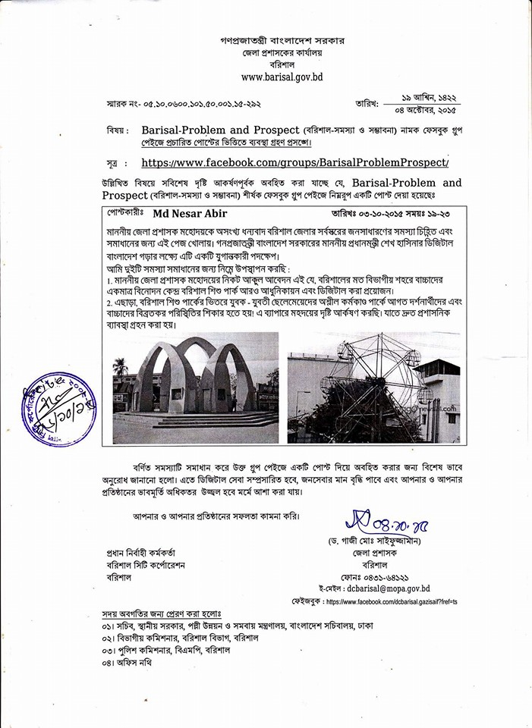
Rural Citizen Journalism for Good Governance

Slide 16
Banning early marriage
Early marriage is being discouraged and illegal in Bangladesh
However, socio-economic condition of this country led the parents towards child marriage
Government Officials in field level offices organize awareness raising program against early marriage
Therefore, many districts are made free from early marriage practice

Slide 17
Digitisation of the Land Management System
On the spot Mutation
Computerization of Record Of Rights (ROR)
To exemplify innovation in public sector service delivery system and to confirm transparency, accountability & mobility, land acquisition (LA) payments have been distributed among the landowners in their own union. As a result, time, cost & number of visit by the applicants have been minimized

Slide 18
Digitisation of the Land Management System: Priorities (case study: Poba)
Modern Records Management
As well as people-oriented service improvement and simplification of procedures
Development of the overall office environment
Motivate employees, increase efficiency, and changing attitudes
By applying digital technology
Land service to the doorsteps of the people

Slide 19
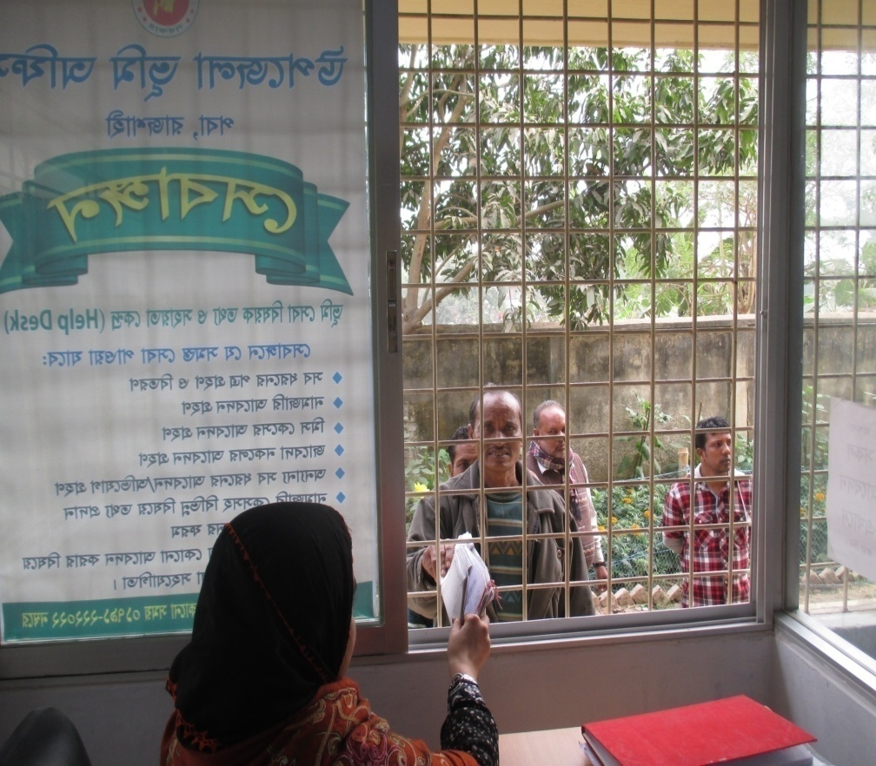

Slide 20
Project Simplification: Innovation in Land Related Miscellaneous Case Disposal (case study: Poba)
The cell phone number of plaintiff is taken in case of miscellaneous cases
The date of the hearing of the case is informed through text message (SMS)
The database of the case has been uploaded to the website
Everyone can see the latest status of the ongoing miscellaneous cases

Slide 21
Palli Janapad for Savings of Agricultural land and community living in rural areas
One building for 300 family (Approx. 1500 people)
1% agricultural land reducing per year.
43 acres of land will be saved
16 km roads will not require to build
17 km electronic line will not require to build
16 common facilities will be available

Slide 22
Palli Janopad for Savings of Agricultural land and community living in rural areas
Agriculture land require 5%+ organic fertilizer (now it is less than 1%)
1 MT organic fertilizer will be available per day from cowdung, toilet and kitchen wastages
Bio-gas of 10 million taka will be available in each year for consumption of the dwellers of the building
400 cattle (at least one for each family ) and poultry (27 per family) facilities will be there
Rain water will be used for the dwellers
Electricity will be provided from Solar Panel

Slide 24
Site & Internal View

Slide 25
Solar Panel

Slide 26
Farm House
Collecting rainy water

Slide 27
Bio-gas Plant
Produce Fertilizer

Slide 28
Thank you

