Slide 1
Government of India Cabinet Secretariat
Bridging the Implementation Gap
Innovation in Disposal of Government Business

Slide 2
Disposal of Government business
Ministries primarily responsible for allocated business
Cabinet/Cabinet Committees mainly from administrative and investment angles
Other Authorities

Slide 3
Cabinet Committee on Investment
Mandate distinct from other Cabinet Committees
Accords no Administrative/Investment approvals but endeavor to cut delays
Facilitation of approvals/clearances and monitoring
Meetings held even if inter-departmental consultative processes are not complete
Clear time-frames for action to be monitored by the Committee
Information flow from Departments concerned with sectors, Financial Institutions and Investors
Interaction with stake holders at different levels

Slide 4
Project Monitoring Group
Headed by Additional Secretary in Cabinet Secretariat
Interacts with Ministries/Departments/States/Investors through e-CCI
Resolution of Issues or their crystallization for consideration at the level of Cabinet Secretary and Cabinet Committee on Investment.

Slide 5
e-CCI
Paperless Online Investment Projects Management System
Transparent and Investor Friendly platform accessible from any internet PC.
Automated Mailer Notifications to Ministries/Investors
Flow of data between Ministries and Cabinet Secretariat.
Meetings management of PMG or tripartite Groups including automatic generation of meeting notice, agenda and RoD
Generation of Reports

Slide 6
Work Flow

Slide 7
Current users of e-CCI
Total users: 552
Ministries: 37
States: 17
Private investors: 498
Proposed replication in States.
Workshops organized for 11 States

Slide 8
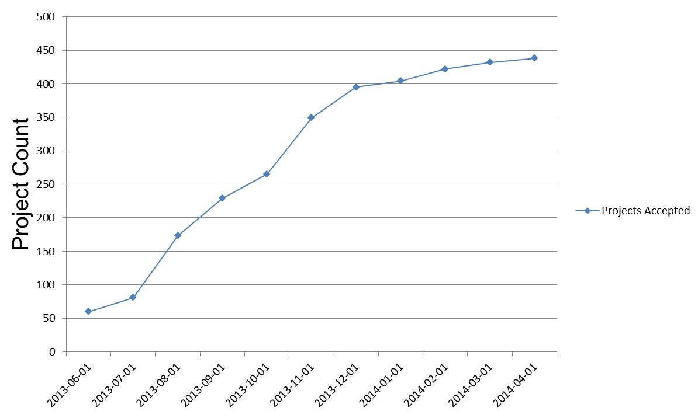
Projects Accepted- Month Wise

Slide 9
Cases considered by PMG
 | No. of Projects | No. of Issues | Value (in Cr)
Projects Accepted by PMG for Consideration | 438 | 1,135 | 21,61,308
Projects/Issues Considered by the Sub-Groups | 426 | 1,029 | 20,70,887
Projects/Issues Closed-No Action Required by PMG | 40 | 325 | 3,39,176
Decisions Taken- Resolved | 154 | 285 | 5,40,305
Projects/Issues for Consideration of CCI | 19 | 64 | 1,15,424
Projects/Issues Still Under Consideration | 213 | 355 | 10,75,981
Projects/Issues to be Considered by the Sub-Groups | 12 | 106 | 90,421

Slide 10
Overall impact
Nearly 300 stalled projects including those recommended by PMG and involving an investment of US $ 1310 billion cleared and Projects found not feasible dropped
Boost to investor confidence
Bottlenecks in terms of provisions of notifications etc. removed.

Slide 11
Further References
http://cabsecpmg.gov.in
User Manual for Entrepreneurs
http://cabsecpmg.gov.in/showpdf.php?type=cci_usermanual
An Article on “e-CCI: Projects Management System” has been published in an e-governance journal “INFORMATICS”, Vol. 22 No. 3. January 2014 page 26-27, at the below link.
http://informatics.nic.in/uploads/pdfs/ca8d1375_Informatics%20January%202014.pdf

Slide 12
Thank You

