Slide 1
Female Community Health Volunteer (FCHV) Program
Ministry of Health & Population
Government of Nepal

Slide 2
Objectives of the Program
To support community involvement in public health activities in order to achieve national health goals
To enhance knowledge and skills of women in community health for their empowerment
To increase community awareness on health related issues
To strengthen community ownership for long term sustainability in promoting health care

Slide 3
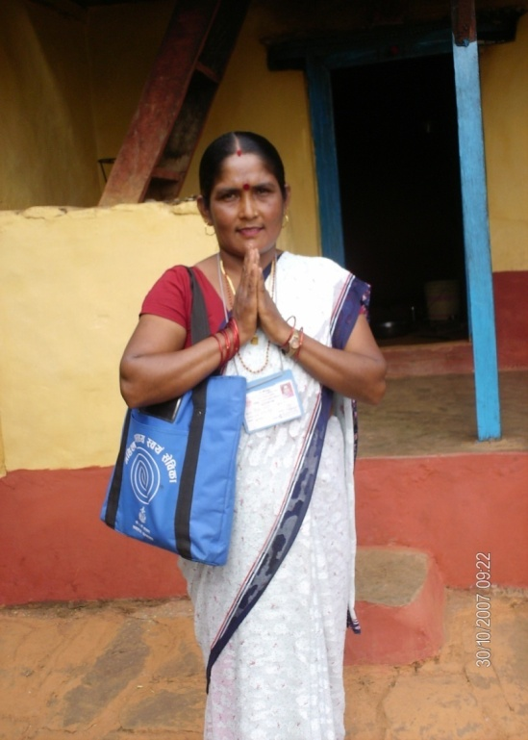


The Health Care Delivery System of Nepal
50-100 villages (VDCs)‏
9 wards (Hamlets) (initiated in 1988 )
Population 1000-3000 per ward
50-200 households
One FCHV ~
Per 120 HH
(1:1000 pop^{n} )
52000 FCHVs
75 districts
Notes:
3
Mostly semi to illiterate. No formal training, non-paid volunteers.The Female Community Health Volunteers programme was established in 1989, and now we have approximately 52,000 FCHVs in Nepal.They receive 18 days of basic training after being enrolled as FCHVs.
Nepal has 75 districts that are divided into 4,000 Village Development Committee’s, which are again divided into wards. The smallest administrative unit in Nepal, which is the ward, has at least one FCHV. On average, each FCHV looks after 80 households.
Although over half the FCHVs are unable to read and write, since the initiation of the FCHV programme, they have remained key actors in several successful interventions, including vitamin A distribution, deworming, and immunization campaigns. FCHVs are motivated to work voluntarily especially because of the social recognition they receive in their communities for their work.

Slide 4
Who are FCHVs ?
Women who are willing to work as a volunteer and selected by Health Mother’s Group (HMG) from community
These volunteers support health related program implementation in their areas
FCHV can work as a FCHV up to the age of 60 years

Slide 5
FCHV Supported activities
Family Planning Safe motherhood
Newborn Health Care Immunization
Nutrition Diarrhea
Communicable and epidemic diseases Acute respiratory diseases
Other national program Environmental sanitation
Support in community based program Health education

Slide 6
Role of FCHV
Promote utilization of available health services and raises awareness on health through mother’s group
Support selected drug distribution and disease management activities
Submit monthly report to local health institution

Slide 7
Capacity Building and Motivational Activities for FCHV
Provide 18 days training
Celebration of FCHV Day and Prize distribution on international volunteer’s day (5th December)
Provision of Free health care services
Observation visits (National & International)
Provided identity Card, dress and Program Logo
Recently , postal stamp is issued with FCHV logo
Other facilities from local level
  Bicycle, Watch, Water Filter, Umbrella, Torch Light, Dress etc.

Slide 8
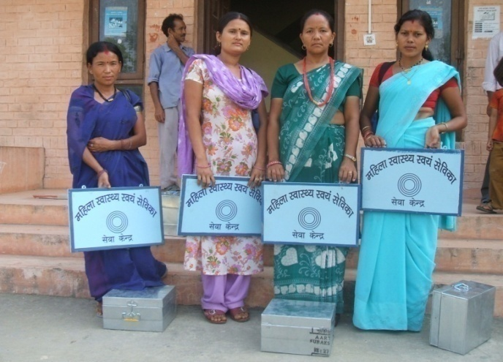
Capacity Development of FCHV

Slide 9
Facilities provided by Government of Nepal (GoN)
To support FCHV economically GoN established in each VDC (3915 VDC) FCHV Fund. GoN deposited up to Rs.90,000 in each FCHV Fund.
Transportation allowances
Provided Rs. 6,000 for dress per year
FCHV Board
Bags
Small box with required drugs and equipment
Other program related materials - posters and pamphlets

Slide 10
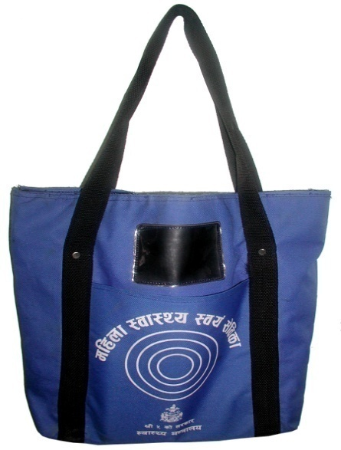
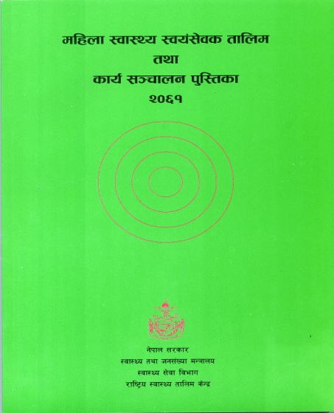
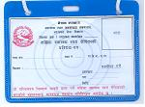
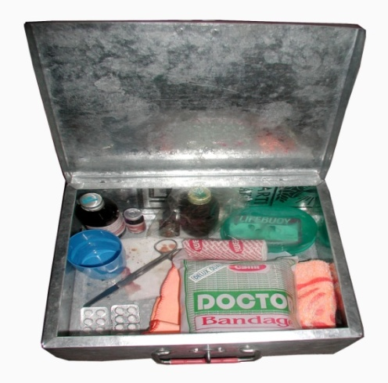
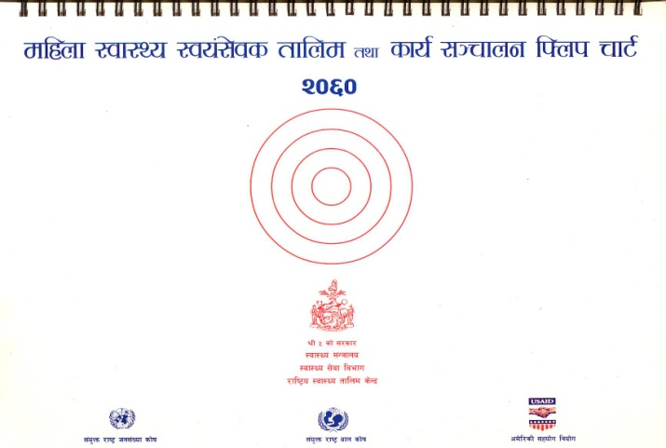
Bag
Identity Card
Signboard
Provided Material for FCHV
Manual
Flip chart
Certificate
Medicine Kit Box
Notes:
10

Slide 11
FCHV Contribution in Selected Health Services
FY 2012/13 to 2014/15

Slide 12
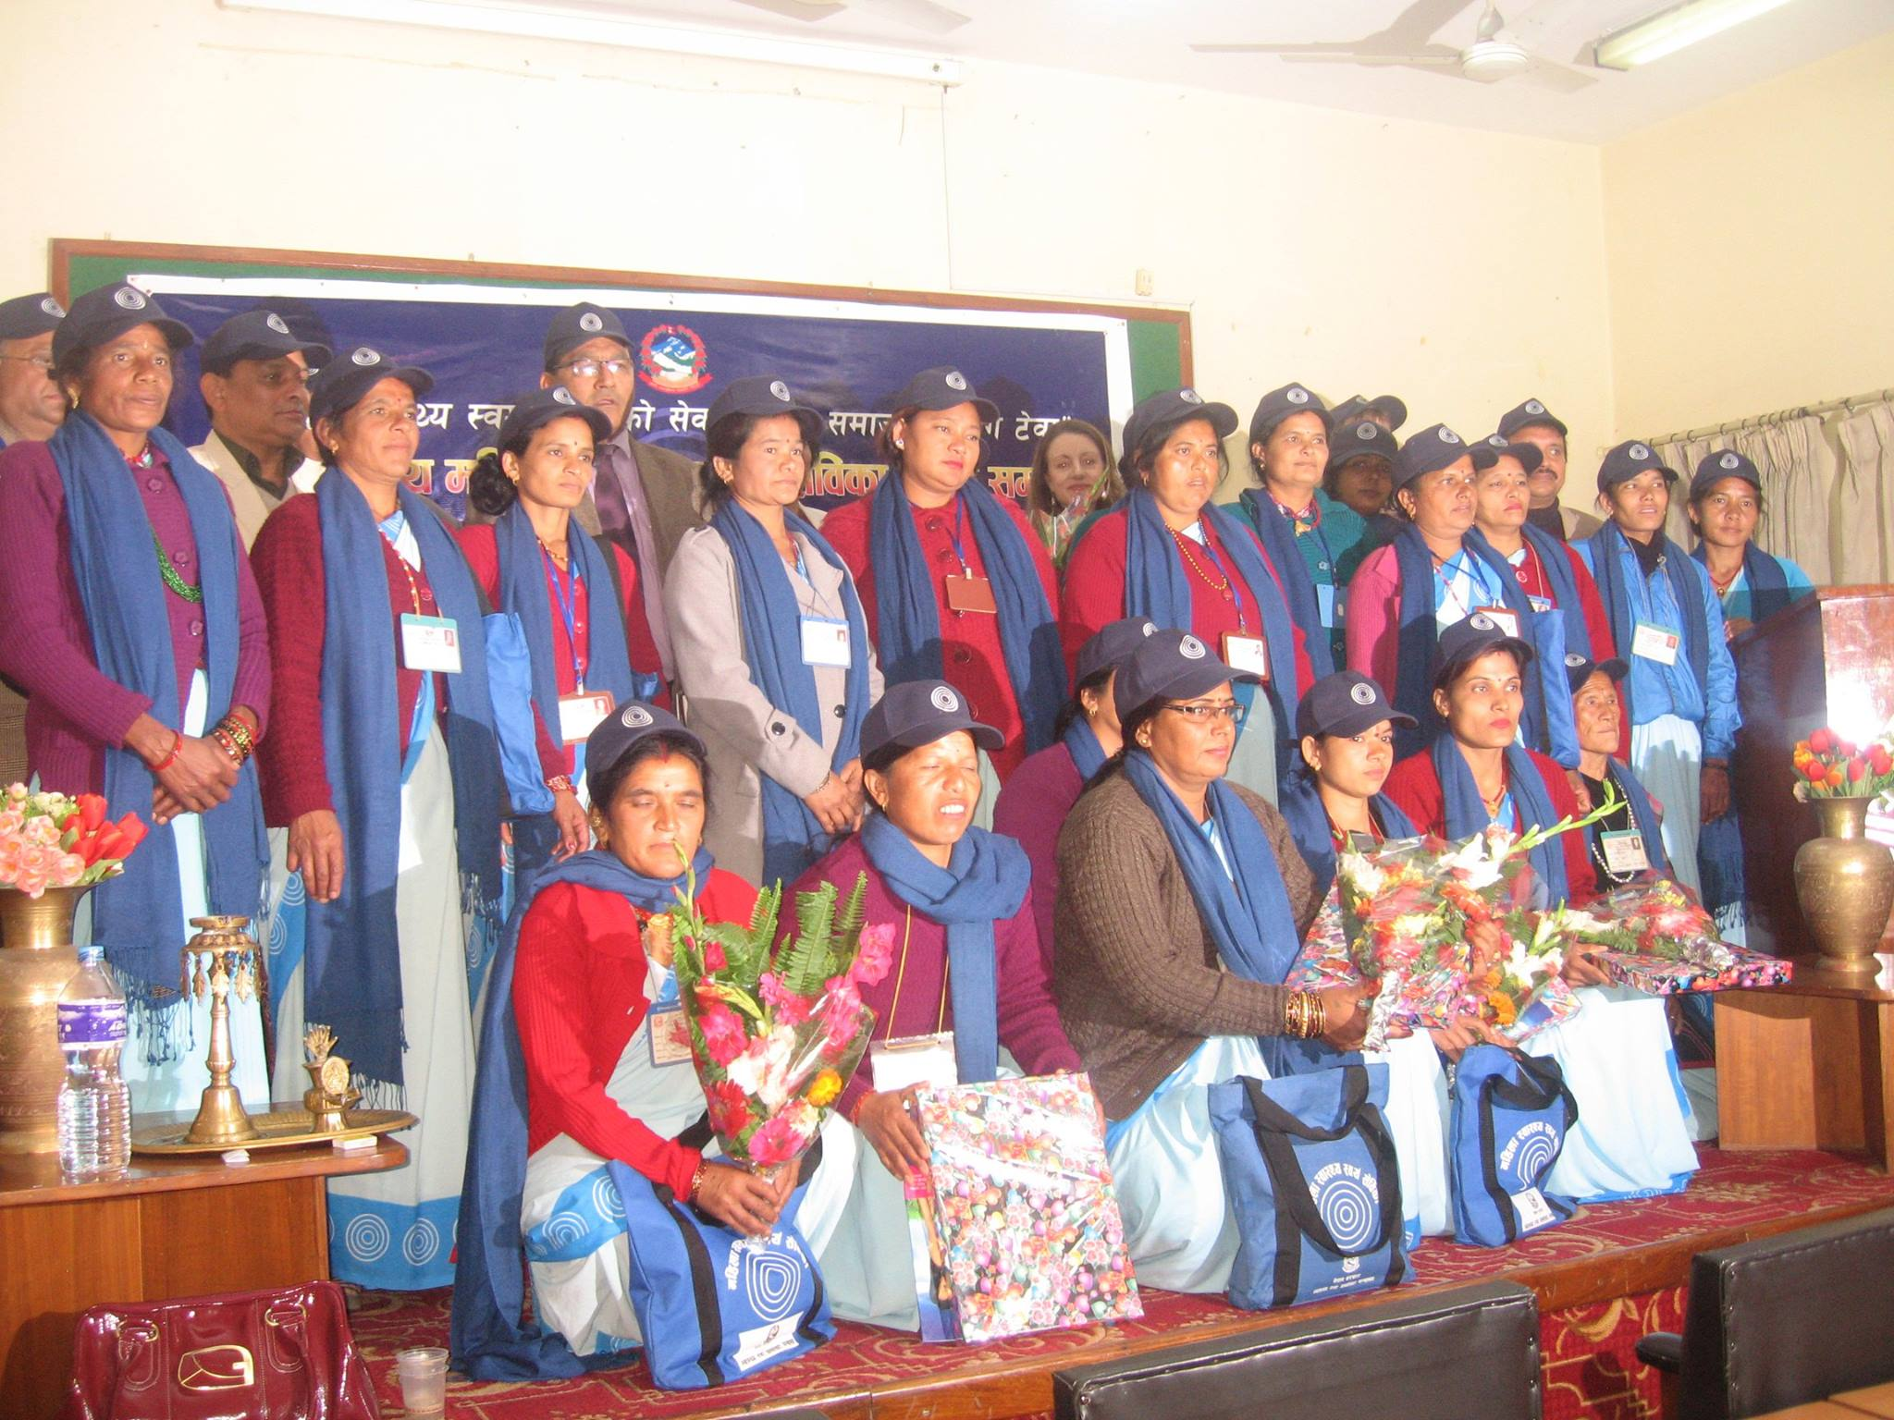
FCHV Day Celebration on 5th Dec., 2014

Slide 13

Postal stamp issued on occasion of Silver Jubilee of FCHV program

Slide 14
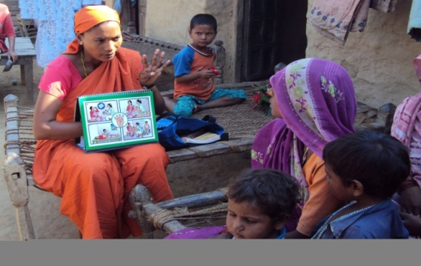
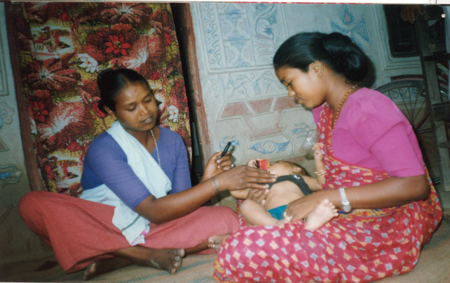
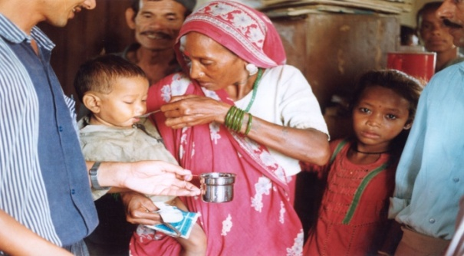
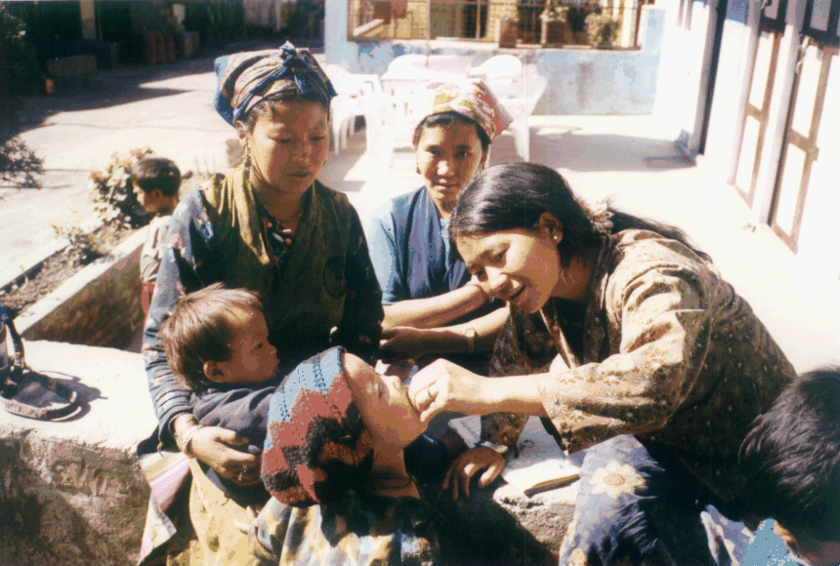
Providing Health Education
Program Activities
Counting respiration
Administering ORS
Vit A dosing
Providing Health Education
Notes:
14
14

Slide 15
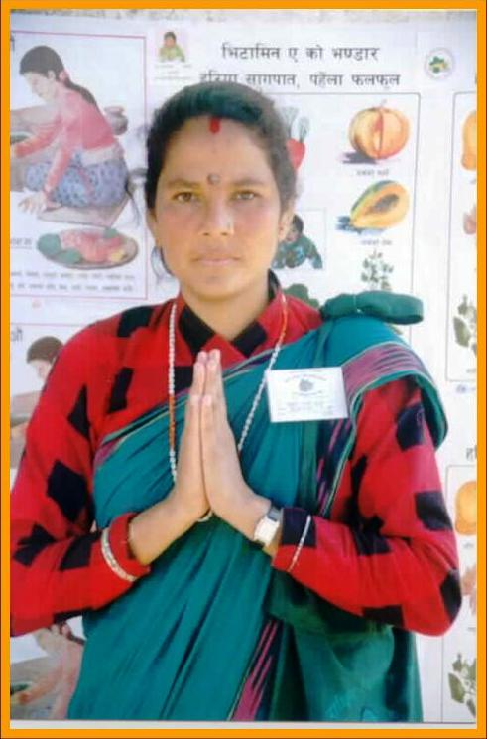
FCHV Program
Thank you
Notes:
15

